Slide 1
🗄️ User Vaults

Slide 2
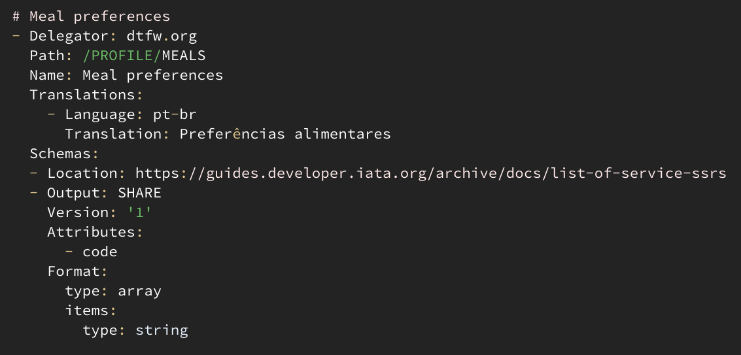
📜 nlweb.org manifest
🏦 Bank 🤵 Broker 💰 Exchange 🤗 Host 🖐️ Palm 💳 Pay 🧢 Persona 📦 Storage 📶 Wi-Fi
🧩 /PROFILE
🧩 //DELIVERY
🧩 //BILLING
🧩 //EMERGENCY
🧩 //ALLERGIES
🧩 //PHONE
🧩 //BOOKING
🧩 //MEALS
🧩 //SOCIAL/NAME
🧩 //SOCIAL/FRIENDLY
🧩 //PARKING
🧩 //TRAVEL/GROUP
🧩 //TRAVEL/SEAT
🧩 //TRAVEL/TAXI
🧩 //TRAVEL/PLACE
CODE

Slide 3
👥 Domain
🧢 Persona 🆔 Identity 💳 Payer 📦 Storage 🏦 Financial agents 🧑‍⚕️ Health agents others…
🗄️ Vaults
bind
2
hello
1
🤵 Broker
📣
🧑‍🦰 Wallet: App
VAULT

